Slide 1
Artificial Intelligence (AI)
Topic 2: Problem Solving Agents (Part -III)

Slide 2
Agenda
Searching for Solutions
Search Strategies
Basic search algorithms
Learning Outcomes : Searching Algorithms
Methodology and Assessment Criteria for the Subject

Slide 3
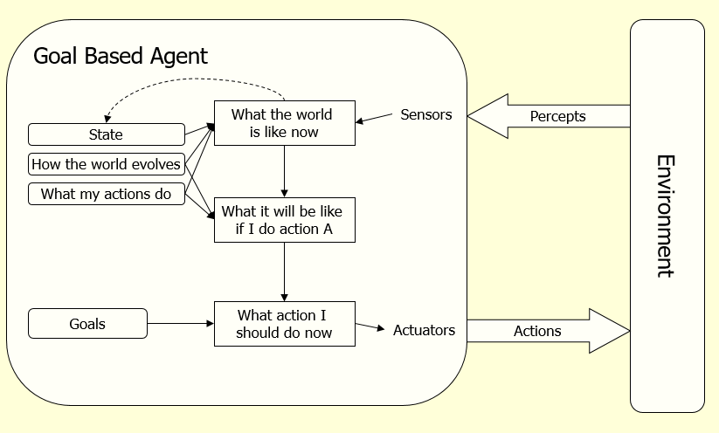
Problem Solving Agents
Function Simple-Problem-Solving-Agent( percept ) returns action
Inputs: percept a percept
Static: seq an action sequence initially empty
state some description of the current world
goal a goal, initially null
problem a problem formulation
state <- UPDATE-STATE( state, percept )
if seq is empty then do
goal <- FORMULATE-GOAL( state )
problem <- FORMULATE-PROBLEM( state, goal )
seq <- SEARCH( problem ) # SEARCH
action <- RECOMMENDATION ( seq ) # SOLUTION
seq <- REMAINDER( seq )
return action # EXECUTION

Slide 4
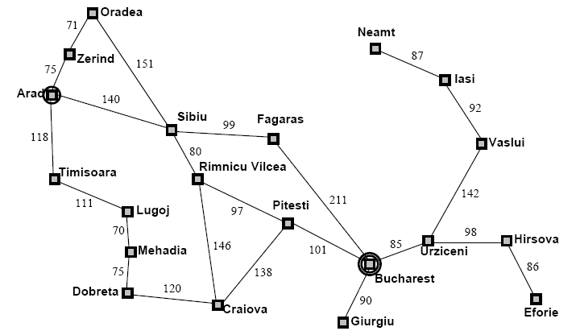
Example: Map Planning (1)

Slide 5
Searching For Solutions (1)
Initial State
e.g. “At Arad”
Successor Function
A set of action state pairs
S(Arad) = {(Arad->Zerind, Zerind), …}
Goal Test
e.g. x = “at Bucharest”
Path Cost
sum of the distances traveled

Slide 6
Searching For Solutions (2)
Having formulated some problems…how do we solve them?
Search through a state space
Use a search tree that is generated with an initial state and successor functions that define the state space

Slide 7
Searching For Solutions (3)
A state is (a representation of) a physical configuration
A node is a data structure constituting part of a search tree
Includes parent, children, depth, path cost
States do not have children, depth, or path cost
The EXPAND function creates new nodes, filling in the various fields and using the SUCCESSOR function of the problem to create the corresponding states

Slide 8
Problem description for a Solution
Components:
State space (explicitly or implicitly defined)
Initial state
Goal state (or the conditions it has to fulfill)
Available actions (operators to change state)
Restrictions (e.g., cost)
Elements of the domain which are relevant to the problem (e.g., incomplete knowledge of the starting point)
Type of solution:
Sequence of operators or goal state
Any, an optimal one (cost definition needed), all

Slide 9
Problem as a State Space Search
To build as system to solve a particular problem, we need:
Define the problem: must include precise specifications ~ initial solution & final solution.
Analyze the problem: select the most important features that can have an immense impact.
Isolate and represent : convert these important features into knowledge representation.
Problem solving technique(s): choose the best technique and apply it to particular problem.

Slide 10
The Quest
Typical questions that need to be answered:
Is the problem solver guaranteed to find a solution?
Will the system always terminate or caught in a infinite loop?
If the solution is found, it is optimal?
What is the complexity of searching process?
How the system be able to reduce searching complexity?
How it can effectively utilize the representation paradigm?

Slide 11
Important Terms
Search space 🡪 possible conditions and solutions.
Initial state 🡪 state where the searching process started.
Goal state 🡪 the ultimate aim of searching process.
Problem space 🡪 “what to solve”
Searching strategy 🡪strategy for controlling the search.
Search tree 🡪 tree representation of search space, showing possible solutions from initial state.

Slide 12
What is Included in Search Algorithm
A problem graph, containing the start node S and the goal node G.
A strategy, describing the manner in which the graph will be traversed to get to G .
A fringe, which is a data structure used to store all the possible states (nodes) that you can go from the current states.
A tree, that results while traversing to the goal node.
A solution plan, which the sequence of nodes from S to G

Slide 13
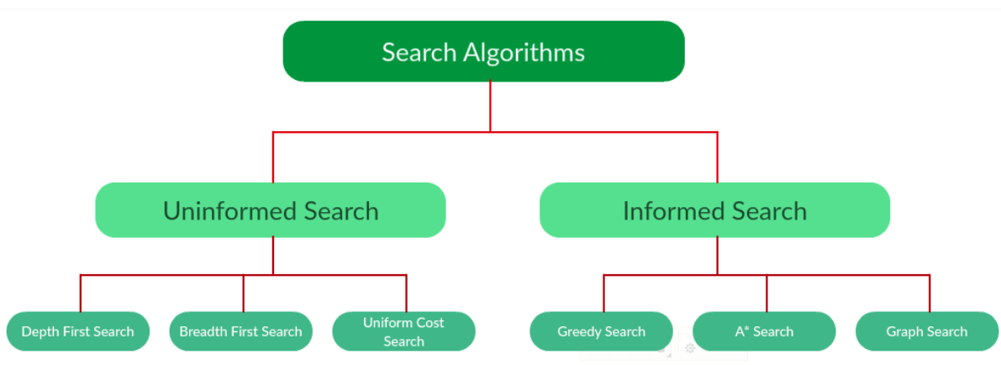
Types of Search Algorithms

Slide 14
Searching Strategies
Blind search 🡪 traversing the search space until the goal nodes is found (might be doing exhaustive search).
Techniques : Breadth First Uniform Cost ,Depth first, Interactive Deepening search.
Guarantees solution.
Heuristic search 🡪 search process takes place by traversing search space with applied rules (information).
Techniques: Greedy Best First Search, A* Algorithm
There is no guarantee that solution is found.

Slide 15
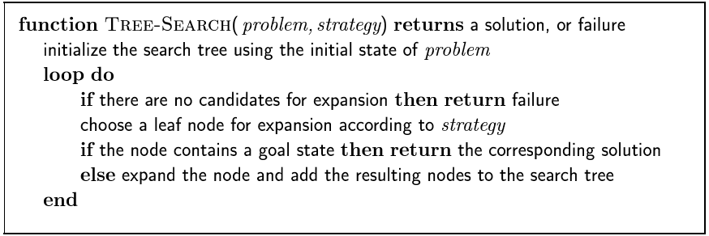
Searching For Solutions (1)

Slide 16
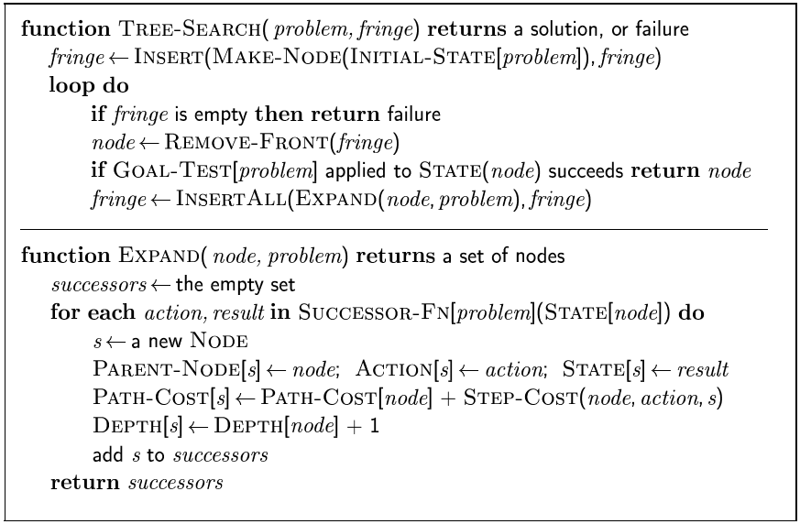
Searching For Solutions (2)

Slide 17
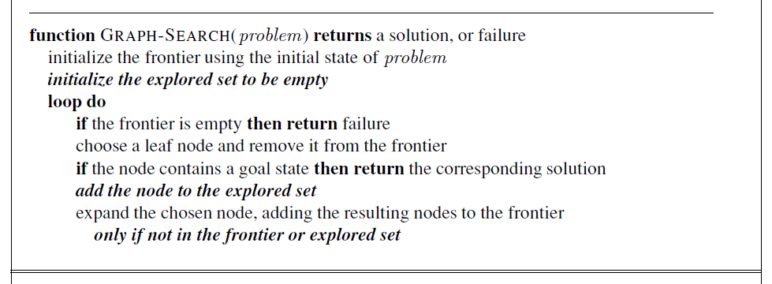
Searching For Solutions (3)

Slide 18
Example: Traveling Salesperson Problem
Suppose a salesperson has five cities to visit and them must return home. Goal 🡪 find the shortest path to travel.
A
B
75
125
125
100
75
E
50
125
C
50
D
100

Slide 19
Searching for Solution
Search through state space (explicitly using searching tree).
Node expansion :- generating new node related to previous nodes.
Concepts:
State :- conditions in which the node corresponds.
Parent node :- the superior node
Path cost :- the cost, from initial to goal state.
Depth:- number of steps along the path from initial state

Slide 20
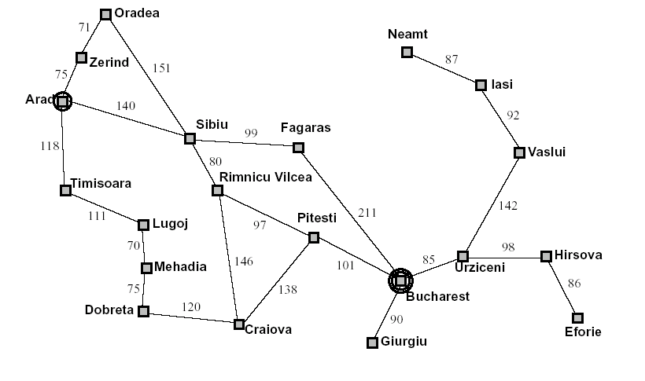
Node expansion

Slide 21
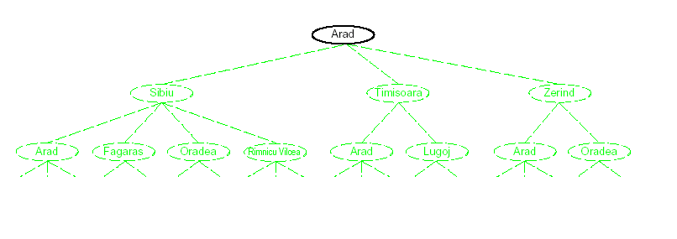
Node expansion (initial)

Slide 22
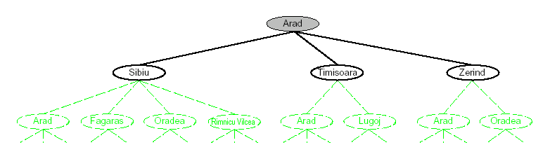
Node expansion (expanding Arad)

Slide 23
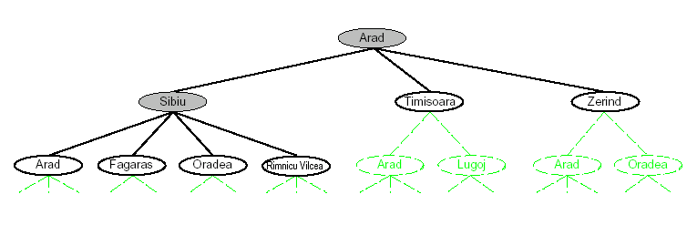
Node expansion (expanding Sibiu)

Slide 24
Measuring Searching Performance
The output from problem-solving (searching) algorithm is either FAILURE or SOLUTION.
Four ways:
Completeness : is guaranteed to find a solution?
Optimality: does it find optimal solution ?
Time complexity: how long?
Space complexity: how much memory?
Complexity : branching factor (b), depth (d), and max. depth (m)

Slide 25
Learning Outcomes with the Topic
Understanding the need of Search Algorithms

Slide 26
Methodology And Assessment Criterias
Class Assignment(s)
Each chapter being covered will have one assignment. The Case Studies will be given in line to the Changing with Speed across IT Projects in Kirirom
Internal Exam(s)
There will be 2 exams
Model Exam
There will be one Model Exam.
Semester Exam
There will be 1 Semester Exam

Slide 27
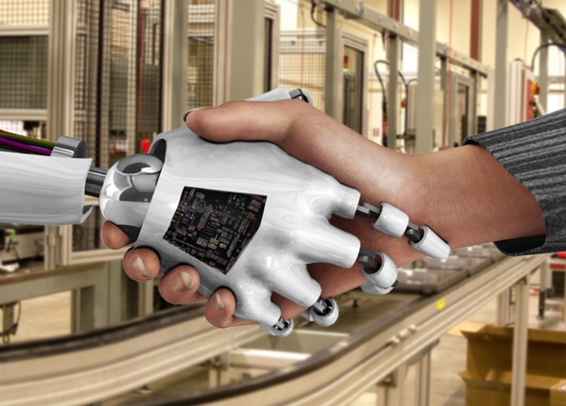
Thank You !
“An Algorithm Must Be Seen to Be Believed”
- Donald Knuth

